Slide 1
IPDK & OPI Testing Goals
The check-in build script did my check-in break the build?
The check-in ‘smoke test’ across all supported targets did my check-in break simple functionality on a target?
The regression test suite did we break something along the way?
The target acceptance test suite does my target support IPDK well enough?
The release test suite what tests are passing at the time of release (across targets)?

Slide 2
Build Script
Re-build IPDK on the KVM P4 DPDK target
Validate that the IPDK build completes without any unexpected errors

Slide 3
Smoke Test
Re-build IPDK on all ‘Accepted’ targets
Run a simple network traffic test (at speed netperf over some ports)
Run a simple storage traffic test (at speed fio over some ports)
Requires:
Available ‘bank’ of back-to-back systems for each target
Ability to build IPDK for each target (ARM, x86, etc.)
Ability to access NDA material for each target
Ability to measure the at speed tests and ensure the perf is expected

Slide 4
Regression Test Suite
Re-build IPDK on all ‘Accepted’ targets
Run a more complete set of tests
Annotation for which tests should be run on each target e.g. skip the storage tests for Tofino
Requires:
Available ‘bank’ of back-to-back systems for each target
Ability to build IPDK for each target (ARM, x86, etc.)
Ability to access NDA material for each target
Ability to measure the at speed tests and ensure the perf is expected
Regression scripting for running tests across different targets

Slide 5
Target Acceptance Test
Running of the regression test suite
Testing its adherence to the TAI (Target Abstraction Interface)
Tooling for running the suite on this target
Marking tests to skip
Adjusting P4 programs or device specific configurations required (per test)
Scripting for integrating non-IPDK codebases such as the device SDK
Annotating expected performance in each of the performance tests
Targets can get into the testing program without being in the release
Requires systems in the ‘bank’ of available targets to run on

Slide 6
Release Test Suite
Running of the regression test suite
Comparing test results w/ expectation for each target
Evaluating if a target belongs in the release (or should be left out)

Slide 7

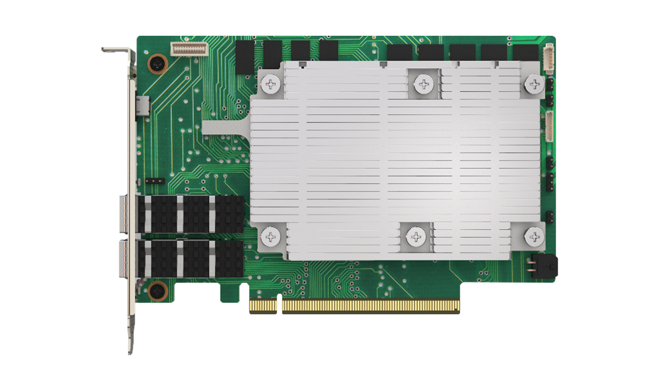
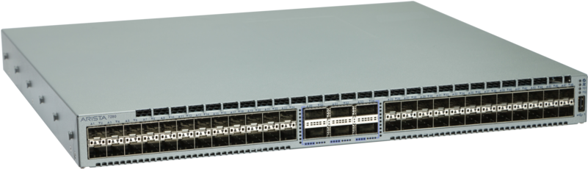

Test Topology
Configuration
Data Collection
Data Collection
Topology Config
Configuration
Data Collection
netperf, fio,
testgen,
To fill pipe
netperf, fio,
testgen
To fill pipe

Slide 8
Traffic Generation
Traffic Gen | Tooling | Measurements
Simultaneous netperf sessions | netperf bi-directional Throughput, pps, packet loss, Latency distribution Large frames, 64B frames w/ cfg | Single port throughput, pps, packet loss, latency distribution Max ports/interface throughput, pps, packet loss, latency distribution
Stateless traffic generation | packetgen bi-directional across different packet sizes / distributions Throughput, packet loss, Latency distribution | Single port throughput, pps, packet loss, latency distribution Max ports/interface throughput, pps, packet loss, latency distribution
fio | fio bi-directional Throughput, IOPS, latency distribution, transport re-transmit Different block sizes (default 4K) | Single disk throughput, IOPS, latency distribution, re-transmits Max disks/interface throughput, pps, latency distribution, re-transmits
Stateful Connection generation | Conngen bi-directional Throughput, connection/sec Latency distribution, transport re-transmit, Different payload sizes | Single port throughput, conn/sec, transport re-transmits, latency distro Max ports/interface throughput, conn/sec, transport re-transmits, latency distro

Slide 9
Test Suite
Test Case | Configuration | Expected Results
Back-to-back L2 | Bridging across server <->network | Wire-like performance card-to-card Packet integrity checks at the switch
Back-to-back L3 | Routing across server <-> network | Wire-like performance card-to-card Packet integrity checks at the switch
Back-to-back vSwitch | VXLAN, NAT, LB, security groups | Wire-like performance card-to-card (adjusted for header adds) Packet integrity checks at the switch
Back-to-back NVMe-o-TCP | Uni-directional Initiator-Switch-Target | Wire-like performance card-to-card Packet integrity checks at the switch
Back-to-back QoS | Rate Limit per device (BW, pps/IOPS) | Test rates below, above and just at config Packet integrity checks at the switch
Back-to-back IPsec | Single tunnel card-to-card Max tunnels card-to-card Max new tunnels/sec card-to-card | Wire-like performance card-to-card (adjusted for header adds) Packet integrity checks at the switch
Back-to-back Secure NVMe-o-TCP | Uni-directional Initiator-Switch-Target Encrypted Writes, De-crypted Reads | Wire-like performance card-to-card Packet integrity checks at the switch
Back-to-back TLS | Single connections card-to-card Max connections card-to-card Max new connections/sec card-to-card | Wire-like performance card-to-card (adjusted for header adds) Packet integrity checks at the switch
Back-to-back NVMe-o-TLS | Single connections card-to-card Max connections card-to-card Max new connections/sec card-to-card | Wire-like performance card-to-card (adjusted for header adds) Packet integrity checks at the switch

Slide 10
Host Interfacing
Host Interface Type | Tooling | Types
Bare Metal Host | PF, Hotplug, SR-IOV Port Speeds | Virtio-net, Virtio-blk, NVMe Device Specific LAN devices
Virtualized Guest | Emulated Device, Hotplug, SR-IOV Port Speeds | Virtio-net, Virtio-blk, NVMe Device Specific VF devices
Container Interface | Kernel veth, ipvlan, SR-IOV | Kernel netdev Device Specific VF devices
TLS Connection

